Slide 1



MENTORING FOR COLLEGE SUCCESS AND CAREER READINESS
Notes:
Samantha

Slide 2
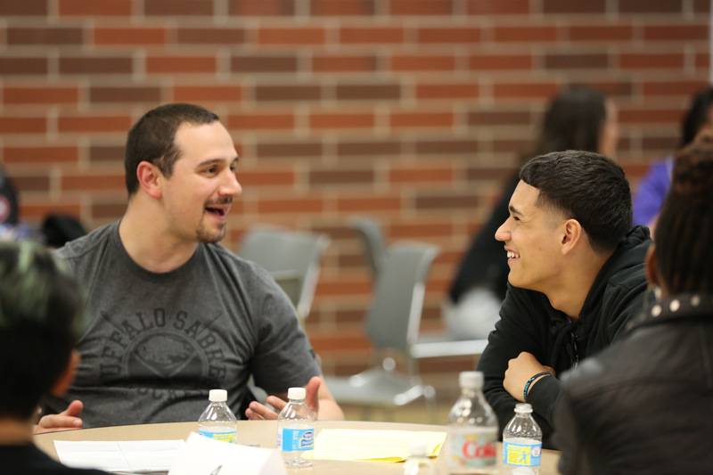
THE POWER OF MENTORING
Notes:
Samantha

Slide 3
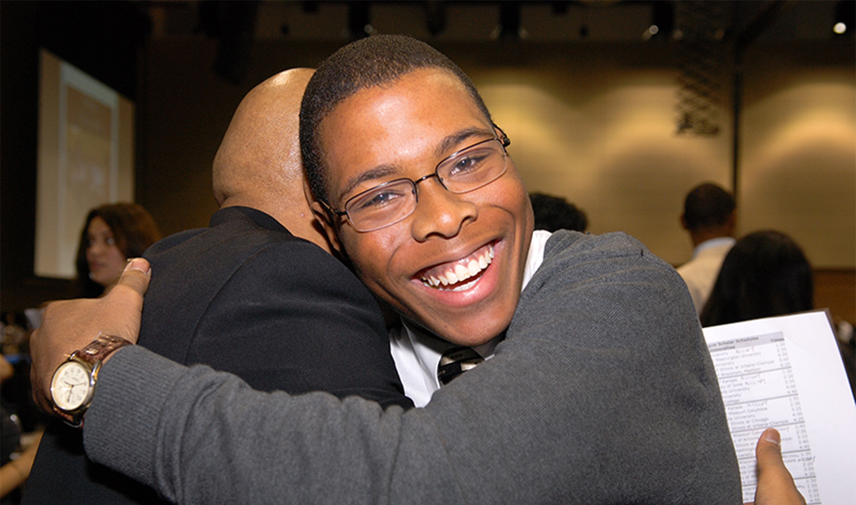
Chicago Scholars Mission:
uniquely select, train, & mentor academically ambitious students from under-resourced communities to complete college & become the next generation of leaders who will transform their neighborhoods & our city
Notes:
Brian

Slide 4
CHICAGO SCHOLARS 7 YEAR PROGRAM MODEL
HIGH SCHOOL: 1 YEAR
COLLEGE: 4 YEARS
ALUMNI: 2 YEARS
COLLEGE ACCESS
COLLEGE SUCCESS
LEADERSHIP & CAREER SUCCESS
COLLEGE COUNSELING
ADULT MENTORS
COHORT OF SUPPORT
EARLY COLLEGE ADMISSIONS
PEER MENTORS
SOCIAL/EMOTIONAL SUPPORT
CAREER LEADERSHIP DEVELOPMENT
CAREER MENTORING
JOB/INTERNSHIPS
ALUMNI LEADERSHIP COUNCIL
CAREER LEADERSHIP DEVELOPMENT
CAREER MENTORING
SUPPORTIVE NETWORK
Notes:
Brian

Slide 5
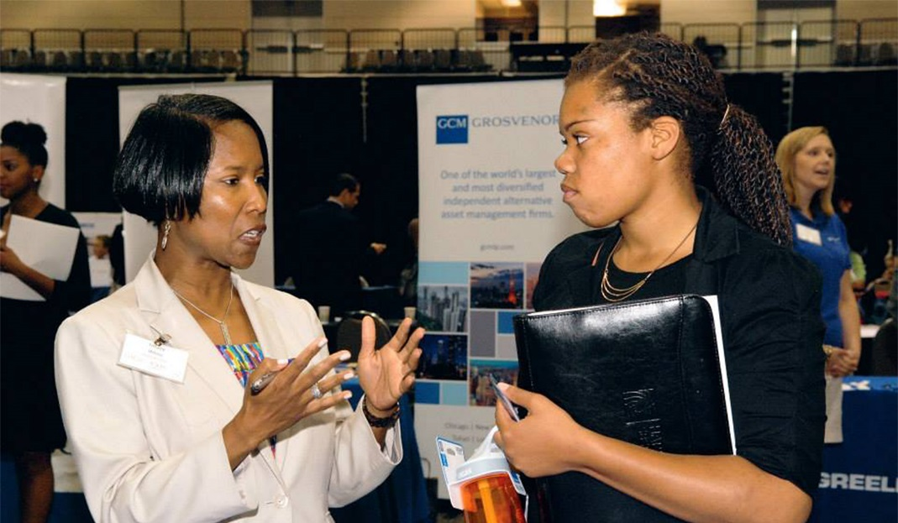
CAREER MENTORING
PROGRAM OVERVIEW
30 minute virtual discussion once a month between 1 mentee & mentor. Pairings are industry specific
Uses suggested guided online curriculum for monthly conversations
Targeted to college upperclassman & recent college grads (max 3 yrs out)
Official program runs from December to May
Application, resume, orientation, monthly reports required, job shadow/info interview required
Notes:
Brian

Slide 6

iMentor matches college graduates
one-on-one with low-income high school students in Chicago.
Notes:
Brenan

Slide 7



The iMentor Program
Schools
Curriculum
Mentors
Support
iMentor partners with schools and serves entire grades of students.
Mentors and mentees work through our college success curriculum in on our online platform and at events.
Every student is matched with a mentor.
An iMentor staff person facilitates the curriculum and supports the pair.
Notes:
Brenan

Slide 8
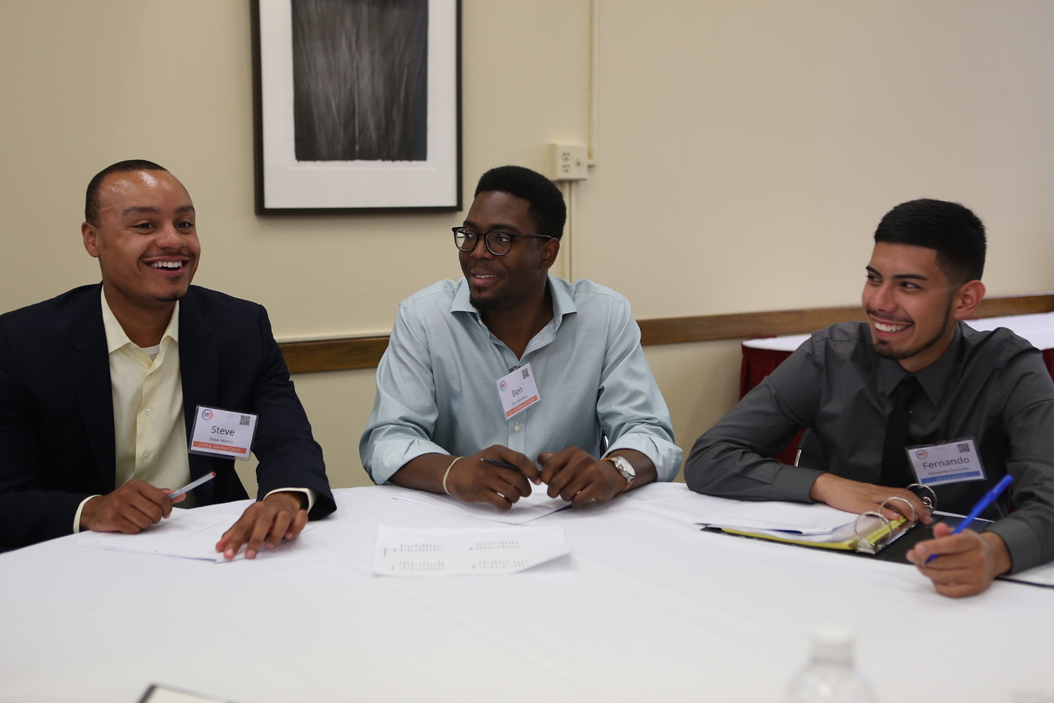
30 MINUTE VIRTUAL DISCUSSION ONCE A MONTH BETWEEN 1 MENTEE & MENTOR
USES SUGGESTED GUIDED ONLINE CURRICULUM FOR MONTHLY CONVERSATIONS
TARGETED TO COLLEGE UPPERCLASSMAN 3 YRS OUT)
OFFICIAL PROGRAM RUNS FROM DECEMBER TO MAY
America Needs You fights for economic mobility for ambitious, first-generation college students. We do this by providing transformative mentorship and intensive career development.
Notes:
Samantha

Slide 9


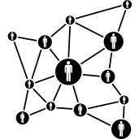

AMERICA NEEDS YOU PROGRAM
Intensive Career Development
One-on-One Mentorship
Robust Networks
Holistic Support
Notes:
Samantha

Slide 10
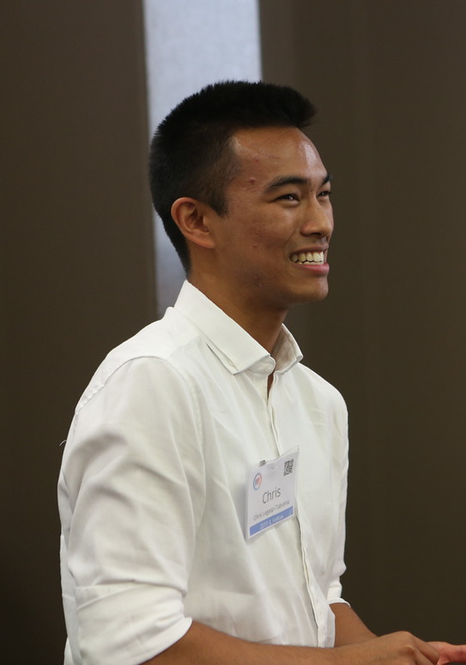
KEY ELEMENTS OF A MENTORING PROGRAM
30 MINUTE VIRTUAL DISCUSSION ONCE A MONTH BETWEEN 1 MENTEE & MENTOR
USES SUGGESTED GUIDED ONLINE CURRICULUM FOR MONTHLY CONVERSATIONS
TARGETED TO COLLEGE UPPERCLASSMAN 3 YRS OUT)
OFFICIAL PROGRAM RUNS FROM DECEMBER TO MAY
RECRUITMENT
TRAINING & SUPPORT
CURRICULUM & ENGAGEMENT
Notes:
Samantha
Something like, “Although we have different approaches to mentoring, we realized that there are key elements to a mentoring program in order to make it successful. We’ve also found that when other organizations approach us for advice, they are often asking about how we do these three things: recruitment, training and support, and curriculum and engagement. Each of us is going to focus on one aspect, starting with Brian on recruitment…”

Slide 11
RECRUITMENT: CHICAGO SCHOLARS
Notes:
Brian

Slide 12
CAREER MENTORING PROGRAM TIMELINE
ONGOING MENTOR RECRUITMENT
FIND MORE MENTORS
STUDENT RECRUITMENT
MATCHING
ORIENTATIONS
BUILD CURRICULUM
BACKGROUND CHECK
NOTIFY OF MATCH
CAREER MENTORING PROGRAM
May-15 JUN JUL AUG SEP OCT NOV DEC JAN FEB MAR APR MAY 16
Notes:
Brian
KEY POINTS:
MENTOR RECRUITMENT HAPPENS YEAR ROUND (POST EVENT EMAILS, WEBSITE)
ONCE STUDENT RECRUITMENT ENDS , POST IT NOTE ROUGH MATCHING TO SEE WHAT OUR NEEDS ARE BASED ON INDUSTRIES STUDENTS REQUEST, AND # OF MENTORS IN THAT FIELD FROM LIST OF MENTORS.
HOW DO WE FIND THE EXTRA MENTORS NEEDED TO FILL THE GAP?
BOARD
ASSOCIATE BOARD
MENTORS (200+)
FAMILY AND FRIENDS
ONLINE

Slide 13
30 MINUTE VIRTUAL DISCUSSION ONCE A MONTH BETWEEN 1 MENTEE & MENTOR
USES SUGGESTED GUIDED ONLINE CURRICULUM FOR MONTHLY CONVERSATIONS
TARGETED TO COLLEGE UPPERCLASSMAN & RECENT COLLEGE GRADS (MAX 3 YRS OUT)
OFFICIAL PROGRAM RUNS FROM DECEMBER TO MAY
TRAINING & SUPPORT: iMENTOR
Notes:
Brenan

Slide 14

STEP 1: MENTOR ORIENTATION
Notes:
Brenan

Slide 15
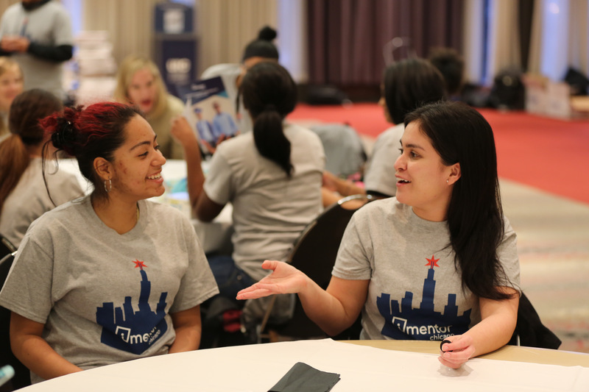
STEP 2: MATCHING
Notes:
Brenan

Slide 16


STEP 3: FITTING MENTORS BUSY SCHEDULES
One Email per week One In Person Meeting /Month
Notes:
Brenan

Slide 17

STEP 4: GUIDED CURRICULUM
Notes:
Brenan

Slide 18
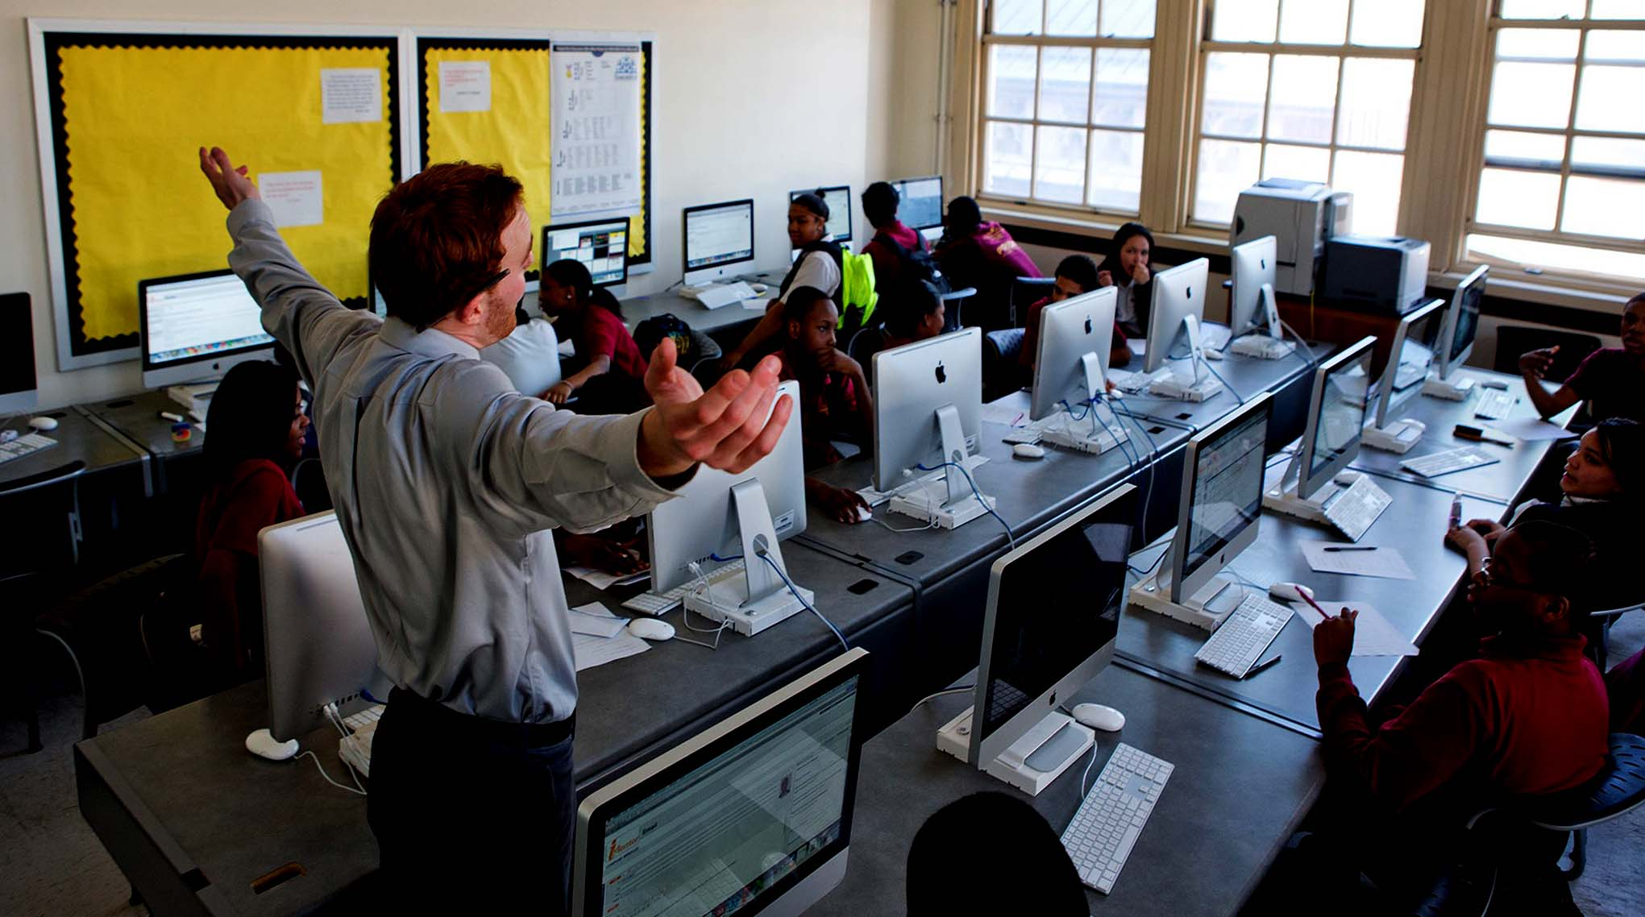
STEP 5: STAFF SUPPORT
Notes:
Brenan

Slide 19
CURRICULUM & PROGRAM: ANY
Notes:
Samantha

Slide 20
CAREER DEVELOPMENT CURRICULUM
Program Design
Engaging Volunteers
Holistic Partnerships
Notes:
*
Samantha

Slide 21
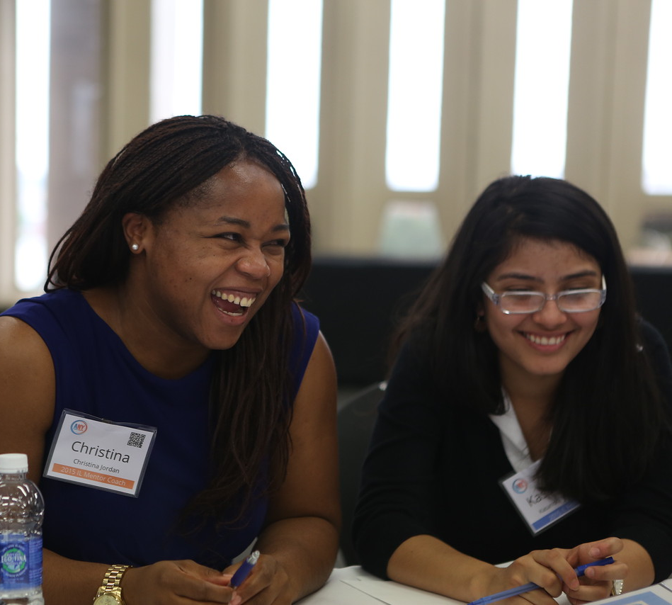
STUDENT NEEDS
Select – limited information, media offers main exposure
Secure – struggle to communicate strengths and match employer needs, support is seen as too generic
Succeed – unwritten rules, no safe space to practice
Source: BCG and ANY Survey 2013
Notes:
*
Samantha

Slide 22
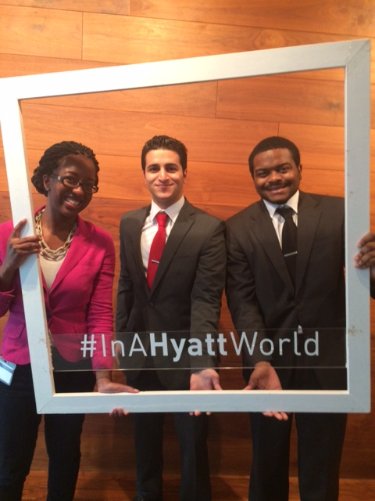
EMPLOYER NEEDS
Work in a team structure;
Make decisions and solve problems;
Communicate verbally;
Plan, organize and prioritize work;
Obtain and process information;
Source: NACE Job Outlook 2015
Notes:
*
Samantha

Slide 23
ANY WORKSHOP TOPICS
Career Interests
Elevator Pitches
Internships
Resumes
Professional Etiquette
Networking
Industry Panels
SMART Goals
Self-Advocacy
Cover Letters
Interviewing
Online Presence
Financial Planning
Time Management
Interdependence
Personal Board of Directors
Public Speaking
Building Resilience
Unwritten Rules of the Workplace
Presentations Communication Styles
Managing Up
Leveraging Strengths
Complex Decision Making
Organizational Culture
Emotional Intelligence
Performance Evaluations
Entrepreneurship
Leadership
Project Management
Life After College
Notes:
Samantha

Slide 24
ANY CURRICULUM:
PRACTICE & APPLICATION
10:00-10:20
Welcome, Goals, Agenda, Recap
11:00-11:30
Internship search process
11:50-12:10
Components of an effective resume
12:10-12:30
Proofing resumes
Lunch
1:30-1:45
ANY Resume
1:45-2:20:
Brainstorming resume content
2:20-2:55
Drafting resume
2:55-3:20
Reviewing draft
10:20-11:00
Intro to Internships
11:30-11:50
Review example resumes
3:20-4:00
Closing rituals
Notes:
Samantha
30% new material; 70% practice and application
Example Workshop: Intro to Internships & Resumes
Fellows Hour
10:00-10:20: Welcome, Goals, Agenda, and Recap from previous workshop
10:20-11:00: Intro to Internships
Mentor Coaches Join
11:15-11:30: ANY Internship Search Process
11:30-11:50: Reviewing example resumes for effectiveness and discussing pros and cons or the style and tone
11:50-12:10: Components of an Effective Resume
12:10-12:30: Proofing Resumes
12:30-1:30: Lunch
1:30-1:45: ANY Resume guidelines
1:45-2:20: Breakout groups on resume writing process then work in pairs on brainstorming content
2:20-2:55: Draft Resume in pairs
2:55-3:20: Review draft with a new Mentor Coach
3:20-4:00: Closing rituals

Slide 25
UTILIZING MENTOR COACHES
One-on-one and community support
Panels
Guest facilitation
Industry knowledge
Career exposure
Networking

Slide 26
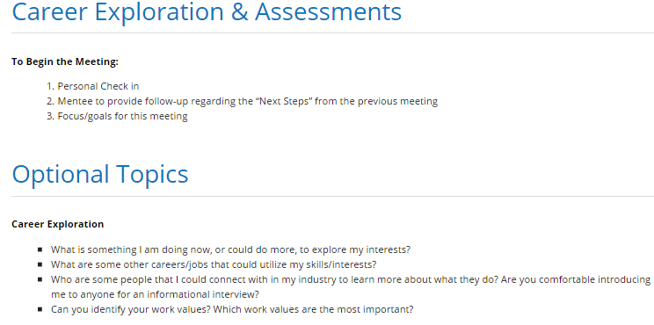
CHICAGO SCHOLARS CURRICULUM
SAMPLE TOPIC: CAREER MENTORING CURRICULUM: PAGE 1GE 1)
30 MINUTE VIRTUAL DISCUSSION ONCE A MONTH BETWEEN 1 MENTEE & MENTOR
USES SUGGESTED GUIDED ONLINE CURRICULUM FOR MONTHLY CONVERSATIONS
TARGETED TO COLLEGE UPPERCLASSMAN & RECENT COLLEGE GRADS (MAX 3 YRS OUT)
OFFICIAL PROGRAM RUNS FROM DECEMBER TO MAY
Notes:
Brian

Slide 27
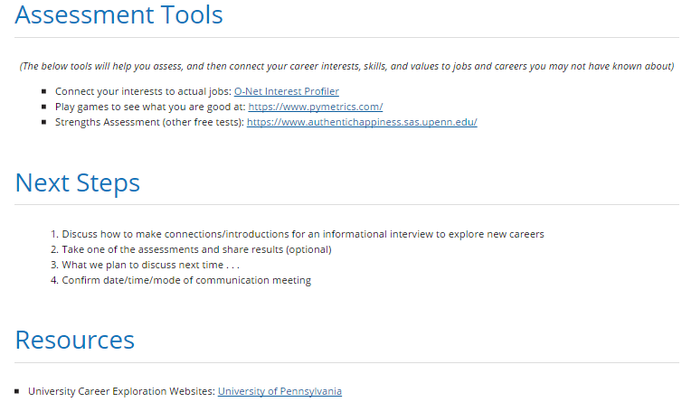
SAMPLE TOPIC: CAREER MENTORING CURRICULUM: PAGE 2GE 1)
30 MINUTE VIRTUAL DISCUSSION ONCE A MONTH BETWEEN 1 MENTEE & MENTOR
USES SUGGESTED GUIDED ONLINE CURRICULUM FOR MONTHLY CONVERSATIONS
TARGETED TO COLLEGE UPPERCLASSMAN & RECENT COLLEGE GRADS (MAX 3 YRS OUT)
OFFICIAL PROGRAM RUNS FROM DECEMBER TO MAY
Notes:
Brian

Slide 28
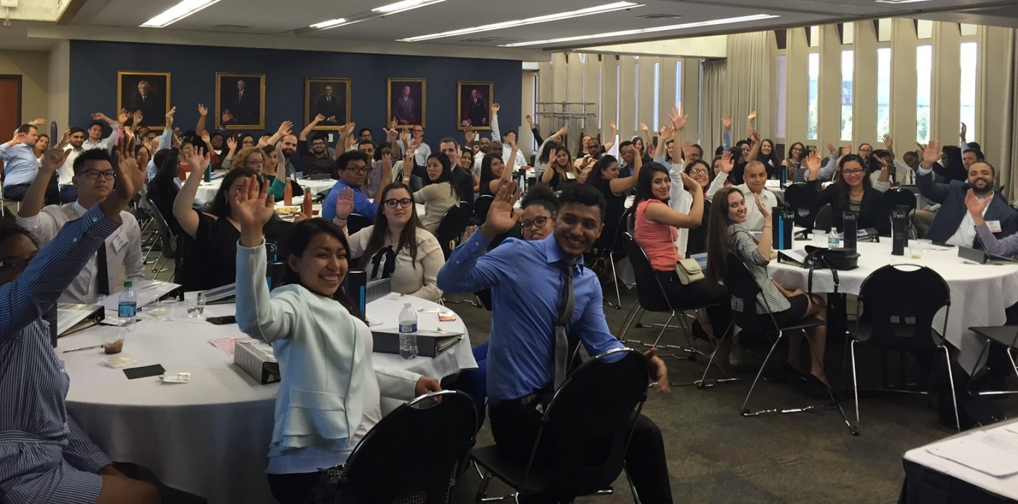
QUESTIONS?
Notes:
Brian

Slide 29
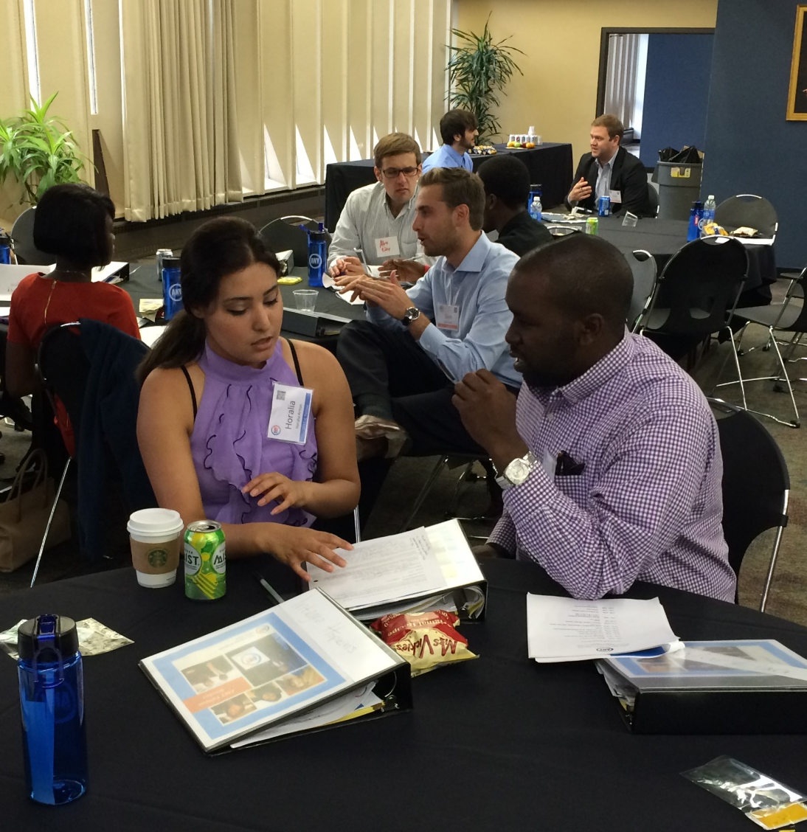
ACTIVITY
Share your biggest challenge with recruiting, training & support, or curriculum and engagement.
Discuss how you might implement one of the strategies discussed.
Brainstorm ways you could collaborate with other organizations to achieve your goals.
Notes:
Brenan

Slide 30
PRESENTER CONTACT INFO
30 MINUTE VIRTUAL DISCUSSION ONCE A MONTH BETWEEN 1 MENTEE & MENTOR
USES SUGGESTED GUIDED ONLINE CURRICULUM FOR MONTHLY CONVERSATIONS
TARGETED TO COLLEGE UPPERCLASSMAN & RECENT COLLEGE GRADS (MAX 3 YRS OUT)
OFFICIAL PROGRAM RUNS FROM DECEMBER TO MAY
BRIAN SOCALL: CHICAGO SCHOLARS
BSOCALL@CHICAGOSCHOLARS.ORG
BRENAN SMITH-EVANS: iMENTOR
BSMITHEVANS@IMENTOR.ORG
CURRICULUM & PROGRAM: ANY
SAMANTHA.ROBINSON
@AMERICANEEDSYOU.ORG
Notes:
Brenan

